Slide 1
Finding Safety Knowledge in LLMs
Activation Probing • Neuron-Level Analysis • Sparse Autoencoders
A comparative framework for studying where safety-related information lives,
how it can be interpreted, and how to test whether it is causally important.
Based on Zhao et al., “Unraveling LLM Jailbreaks Through Safety Knowledge Neurons” (arXiv:2509.01631v2, 2026)

Slide 2
1. Activation probing
Probe the model’s internal representations before trying to identify individual units.
• Collect hidden-state or activation vectors for two controlled prompt groups: harmful (H) and benign (B).
• Compare the representations: means, separability, classifiers/probes, or other statistical tests.
• If a probe can reliably distinguish H from B, the activation space contains information related to safety.
• This answers a representation-level question — not necessarily which individual neuron or feature stores the information.
• A useful next step is to identify the layers/positions where the separation is strongest, then inspect those activations more closely.
Input groups
Harmful prompts vs benign prompts
What you learn
“Safety information is encoded here.”
Main limitation
Encoding ≠ causal control
Safety Knowledge in LLMs • Activation Probing vs Neuron Analysis vs SAE | 4

Slide 3
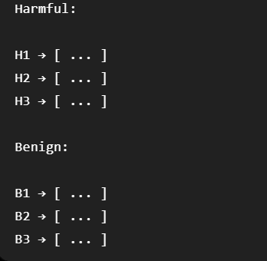
We extract the activation vectors at a particular layer.
Can these activations distinguish harmful from benign inputs?

Slide 4
2. Neuron-level analysis
aᵢˡ = σ(sₗ θᵢˡ)
cᵢˡ = aᵢˡ × ‖rᵢˡ‖
Calculate activation of neuron
Estimate contribution of neuron
A. Activation
B. Output direction
C. Contribution
θᵢˡ is the i-th column of the MLP up-projection matrix.
The neuron activates according to the current input representation.
rᵢˡ is the i-th row of the down-projection matrix.
It represents the neuron’s contribution direction in the MLP output.
Activation × output-vector magnitude gives
a contribution score.
Top-k neurons are retained per layer.
Safety Knowledge in LLMs • Activation Probing vs Neuron Analysis vs SAE | 5

Slide 5
Interpreting the identified neurons
The paper projects the refined safety-neuron representation into vocabulary space.
pᴮ = average safety-neuron representation on benign prompts
pᴴ = average safety-neuron representation on harmful prompts
dᶜ = pᴮ − pᴴ (compliance direction)
dʳ = pᴴ − pᴮ (rejection direction)
Vocabulary-space interpretation
Observed conceptual contrast
Projecting the representation into vocabulary space makes the dominant concepts more interpretable.
Benign-related projections include compliance/safety concepts; harmful-related projections include refusal/impossibility concepts.
Safety Knowledge in LLMs • Activation Probing vs Neuron Analysis vs SAE | 7

Slide 6
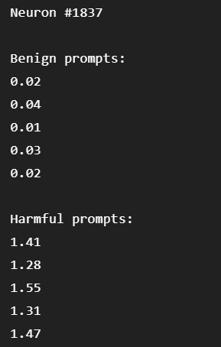
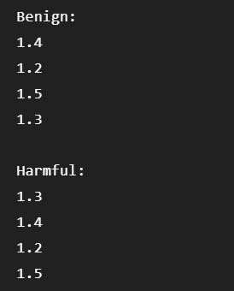
V/S
General Purpose neuron

Slide 7
3. Sparse Autoencoders (SAEs)
SAEs change the unit of analysis: from native neurons to learned sparse features.
x → Encoder → z (sparse features) → Decoder → x̂
• Input x is typically a dense activation vector collected from a chosen model layer.
• The encoder maps x into a larger latent space z.
• A sparsity objective encourages only a small number of latent features to activate for each input.
• Each latent feature can sometimes correspond to a more coherent concept than a raw model neuron.
• For safety research, compare feature activations across harmful and benign prompts to identify safety-associated features.
Candidate score
Δⱼ = E[zⱼ | H] − E[zⱼ | B]
Then interpret
Inspect examples that strongly activate feature j and determine whether the feature is safety-related.
Important
SAE features ≠ native neurons
Safety Knowledge in LLMs • Activation Probing vs Neuron Analysis vs SAE | 9

Slide 8
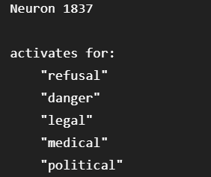

Polysemanticity
One neuron may respond to multiple seemingly unrelated concepts.
An SAE attempts to decompose a dense neural activation into a set of sparse, more interpretable features.
Before SAE
After SAE

Slide 9
Activation probing vs neuron analysis vs SAE
Dimension
Activation probing
Neuron-level analysis
SAE
What is inspected
Activation vectors
Native MLP neurons
Learned sparse features
Main question
Is safety information encoded?
Which neurons carry it?
Which interpretable features encode it?
Granularity
Layer / representation
Individual model units
Feature-level latent space
Interpretability
Moderate
Direct but can be polysemantic
Potentially high
Handles polysemanticity
Not directly
Limited
One of its main motivations
Native to model?
Yes
Yes
No — learned decomposition
Causal test needed?
Yes
Yes
Yes
Safety Knowledge in LLMs • Activation Probing vs Neuron Analysis vs SAE | 10

Slide 10
Thank you
Source: Zhao et al. (2026), “Unraveling LLM Jailbreaks Through Safety Knowledge Neurons,” arXiv:2509.01631v2.

